Slide 1
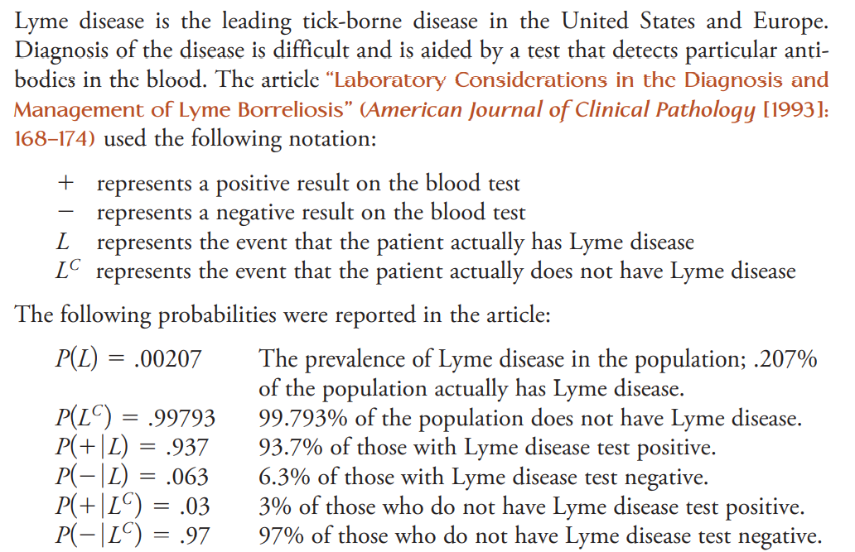

Slide 2
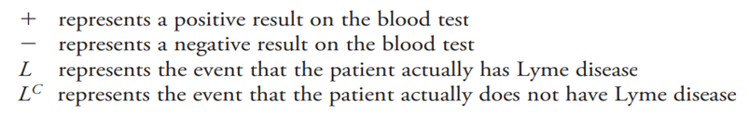
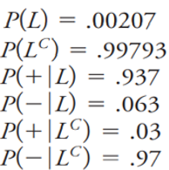
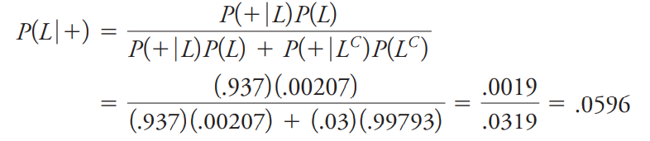
Given that a person tests positive for the disease, what is the probability that he or she actually has Lyme disease?

Slide 3
Independence
Two events (A & B) are independent if knowing the outcome of one event does not affect the probability that the other event will occur.
P(A|B) = P(A)

Slide 4
Formal Multiplication Rule
The formal multiplication rule (all events)…
$$P(A∩B) = P(A)∗P(B|A)$$
Independence:
P(B) = P(B|A)
For independent events only…
$$P(A∩B) = P(A)∗P(B)$$

Slide 5
Independent vs. Mutually Exclusive
Mutually exclusive: when events that have no intersection (i.e. they cannot both occur)
P(A) = 0.80
P(A|B) = ?
A
B
0.80
0.20

Slide 6
Independent vs. Mutually Exclusive
Mutually exclusive: when events that have no intersection (i.e. they cannot both occur)
P(A) = 0.80
P(A|B) = 0.00
A
B
0.80
0.20
Mutually exclusive events are not independent. Knowing that one event occurs greatly affects the probability of the other event (lowers it to 0).

